Slide 1
The Evolution of Management Thought
chapter two
McGraw-Hill/Irwin
Contemporary Management, 5/e
Copyright © 2008 The McGraw-Hill Companies, Inc. All rights reserved.

Slide 2
Learning Objectives
Describe how the need to increase organizational efficiency and effectiveness has guided the evolution of management theory
Explain the principle of job specialization and division of labor, and tell why the study of person-task relationships is central to the pursuit of increased efficiency
Identify the principles of administration and organization that underlie effective organizations
Trace the change in theories about how managers should behave to motivate and control employees
Explain the contributions of management science to the efficient use of organizational resources
Explain why the study of the external environment and its impact on an organization has become a central issue in management thought
2-<number>

Slide 3
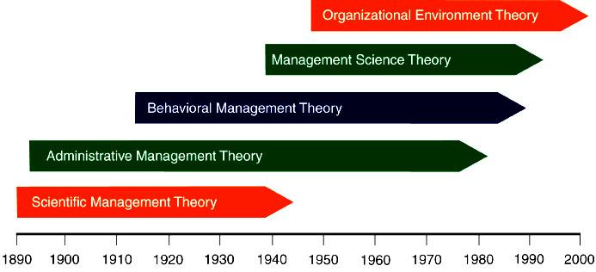
The Evolution of Management Theory
Figure 2.1
2-<number>

Slide 4
Job Specialization and the Division of Labor
Adam Smith (18th century economist) Observed that firms manufactured pins in one of two different ways:- Craft-style—each worker did all steps.
    Production—each worker specialized in one step.
What is the process by which a division of labor occurs as different workers specialize in specific tasks over time?
Job Diversification
Job Sterilization
Job Specification
Job Specialization
2-<number>

Slide 5
Job Specialization and the Division of Labor
Job Specialization
  process by which a division of labor occurs as different workers specialize in specific tasks over time
Workers who specialized became much more skilled at their specific tasks
Increasing job specialization increases efficiency and leads to higher organizational performance
2-<number>

Slide 6
F.W. Taylor and Scientific Management
Scientific Management: The systematic study of the relationships between people and tasks for the purpose of redesigning the work process to increase efficiency.
Four Principles of Scientific Management
  Study the way workers perform their tasks, gather all the informal job knowledge that workers possess and experiment with ways of improving how tasks are performed
    Time-and-motion study
2-<number>

Slide 7
Four Principles of Scientific Management
  2) Codify the new methods of performing tasks into written rules and standard operating procedures
  3) Carefully select workers who possess skills and abilities that match the needs of the task, and train them to perform the task according to the established rules and procedures
  4) Establish a fair or acceptable level of performance for a task, and then develop a pay system that provides a reward for performance above the acceptable level
2-<number>

Slide 8
Problems with Scientific Management
Managers frequently implemented only the increased output side of Taylor’s plan.
  Workers did not share in the increased output.
Specialized jobs became very boring, dull.
  Workers ended up distrusting the Scientific Management method.
Workers could purposely “under-perform.”
  Management responded with increased use of machines and conveyors belts.
2-<number>

Slide 9
The Gilbreths
Break up and analyze every individual action necessary to perform a particular task into each of its component actions
Find better ways to perform each component action
Reorganize each of the component actions so that the action as a whole could be performed more efficiently-at less cost in time and effort
2-<number>

Slide 10
Administrative Management Theory
Administrative Management
  The study of how to create an organizational structure that leads to high efficiency and effectiveness.
Max Weber
  Developed the principles of bureaucracy as a formal system of organization and administration designed to ensure efficiency and effectiveness.
2-<number>
Notes:
Organizational structure – system of task and authority relationships that control how employees use resources to achieve the organization’s goals

Slide 11
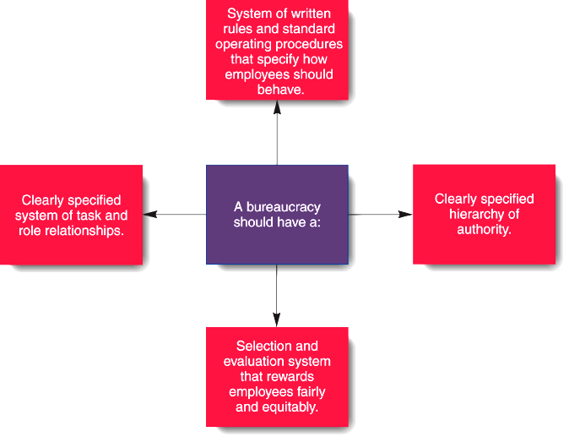
Weber’s Principles of Bureaucracy
Figure 2.2
2-<number>

Slide 12
Weber’s Principles of Bureaucracy
A manager’s formal authority derives from the position he holds in the organization.
People should occupy positions because of their performance, not because of their social standing or personal contacts.
The extent of each position’s formal authority and task responsibilities and it’s relationship to other positions should be clearly specified.
Authority can be exercised effectively when positions are arranged hierarchically, so employees know whom to report to and who reports to them.
Managers must create a well-defined system of rules, standard operating procedures,
and norms so they
can effectively
control behavior .
2-<number>

Slide 13
Rules, SOPs and Norms
Rules – formal written instructions that specify actions to be taken under different circumstances to achieve specific goals
Standard Operating Procedures (SOPs) – specific sets of written instructions about how to perform a certain aspect of a task
Norms – unwritten, informal codes of conduct that prescribe how people should act in particular situations
2-<number>

Slide 14
Fayol’s Principles of Management
Division of Labor: allows for job specialization.
  jobs can have too much specialization leading to poor quality and worker dissatisfaction.
Authority and Responsibility: both formal and informal authority resulting from special expertise.
Unity of Command: Employees should have only one boss.
Line of Authority: A clear chain of command from top to bottom of the firm.
Centralization: The degree to which authority rests at the top of the organization.
Unity of Direction: A single plan of action to guide the organization.
  Initiative - The fostering of creativity and innovation by encouraging employees to act on their own.
2-<number>

Slide 15
Fayol’s Principles of Management
Equity - The provision of justice and the fair and impartial treatment of all employees.
Order - The arrangement of employees where they will be of the most value to the organization and to provide career opportunities.
Discipline: Obedient, applied, respectful employees are necessary for the organization to function.
Remuneration of Personnel: An equitable uniform payment system that motivates contributes to organizational success.
2-<number>

Slide 16
Fayol’s Principles of Management
Stability of Tenure of Personnel: Long-term employment is important for the development of skills that improve the organization’s performance.
Subordination of Individual Interest to the Common Interest: The interest of the organization takes precedence over that of the individual employee.
Esprit de corps:Comradeship, shared enthusiasm foster devotion to the common cause (organization).
2-<number>

Slide 17
Discussion Question?
Which of the following is the most important aspect of Fayol’s principles of management?
Division of Labor
Unity of Command
Remuneration of Personnel
Esprit de corps
2-<number>
Notes:
There is no one best answer. Students should be prepared to discuss consequences of any missing aspect. For example, if there is no unity of command, how will the firm function.

Slide 18
Behavioral Management Theory
Behavioral Management: The study of how managers should personally behave to motivate employees and encourage them to perform at high levels and be committed to the achievement of organizational goals.
Mary Parker Follett: Concerned that Taylor ignored the human side of the organization
    Suggested workers help in analyzing their jobs
    If workers have relevant knowledge of the task, then they should control the task
2-<number>

Slide 19
The Hawthorne Studies
Studies of how characteristics of the work setting affected worker fatigue and performance at the Hawthorne Works of the Western Electric Company from 1924-1932.
  Worker productivity was measured at various levels of light illumination.
  Researchers found that regardless of whether the light levels were raised or lowered, worker productivity increased.
Human Relations Implications: Hawthorne effect — workers’ attitudes toward their managers affect the level of workers’ performance
2-<number>

Slide 20
The Hawthorne Studies
  Human relations movement – advocates that supervisors be behaviorally trained to manage subordinates in ways that elicit their cooperation and increase their productivity
Implications
Behavior of managers and workers in the work setting is as important in explaining the level of performance as the technical aspects of the task
Demonstrated the importance of understanding how the feelings, thoughts, and behavior of work-group members and managers affect performance
2-<number>

Slide 21
‘Hawthorne Effect in modern workplaces.
Listening is important
The Hawthorne effect established that the productivity of employees increased dramatically when they felt they were being heard. It’s important to appreciate ideas.
People are mainly motivated not by economic factors but emotional factors, such as a feeling of being involved and receiving attention. It is important for employees to feel that their concerns are being heard and that they are contributing to a common purpose.
2-<number>

Slide 22
Hawthorne Effect in modern workplaces.
Observation over vigilance(Good job) Paying attention to what employees are doing brings in some wonderful results.
Right people in the right group.
God of small things(motivation don’t need to be in the form of ‘big’ things. Sometimes, small changes work wonders in improving productivity)
2-<number>

Slide 23
Hawthorne Effect in modern workplaces.
Gender diversity.
Women are increasingly entering male-dominated professions. However, they are often made to feel unwanted by male peers, which leads to low productivity. Employers need to be observant and bring in small changes to make the environment more conducive. The individual attention and the normal human nature to feel ‘chosen’ will distort the results
2-<number>

Slide 24
Question?
What theory assumes the average worker is lazy, dislikes work and will do as little as possible?
Theory X
Theory Y
Theory Z
Theory QZ
2-<number>
Notes:
The correct answer is “A”. See slide 2-39.

Slide 25
Theory X and Theory Y
Douglas McGregor proposed the two different sets of assumptions about workers.
  Theory X assumes the average worker is lazy, dislikes work and will do as little as possible.
    Workers have little ambition and wish to avoid responsibility
    Managers must closely supervise and control through reward and punishment.
  Theory Y assumes workers are not lazy, want to do a good job and the job itself will determine if the they like the work.
    Managers should allow workers greater latitude, and create an organization to stimulate the workers.
2-<number>

Slide 26
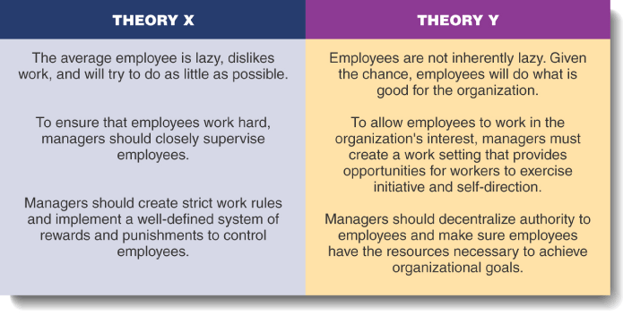
Theory X vs. Theory Y
Figure 2.3
2-<number>

Slide 27
Management Science Theory
Contemporary approach to management that focuses on the use of rigorous quantitative techniques to help managers make maximum use of
organizational resources to produce goods and services.
  Quantitative management — utilizes linear and nonlinear programming, modeling, simulation, queuing theory and chaos theory.
  Operations management —techniques used to analyze any aspect of the organization’s production system.
2-<number>

Slide 28
Management Science Theory
  Total Quality Management (TQM) —focuses on analyzing input, conversion, and output activities to increase product quality.
  Management Information Systems (MIS) — provides information vital for effective decision making.
2-<number>

Slide 29
Organizational Environment Theory
Organizational Environment –
The set of forces and conditions that operate beyond an organization’s boundaries but affect a manager’s ability to acquire and utilize resources
2-<number>

Slide 30
The Open-Systems View
Open System
  A system that takes resources for its external environment and transforms them into goods and services that are then sent back to that environment where they are bought by customers.
  Inputs: the acquisition of external resources to produce goods and services
  Conversion: transforms the inputs into outputs of finished goods and services.
  Output: the release of finished goods and services to its external environment.
2-<number>

Slide 31
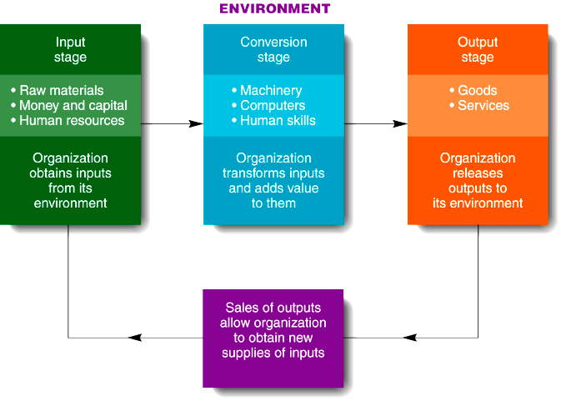
Figure 2.4
2-<number>

Slide 32
Closed System
A self-contained system that is not affected by changes in its external environment.
Likely to experience entropy and lose its ability to control itself
Synergy – the performance gains that result from the combined actions of individuals and departments
  Possible only in
  an organized system
2-<number>

Slide 33
Contingency Theory
“There is no one best way to organize”
The idea that the organizational structures and control systems manager choose depend on—are contingent on—characteristics of the external environment in which the organization operates.
2-<number>

Slide 34
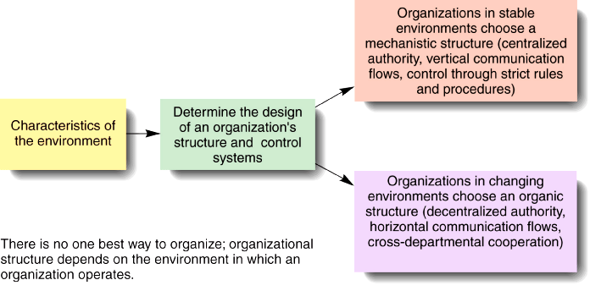
Contingency Theory
Figure 2.5
2-<number>

Slide 35
Type of Structure
Mechanistic Structure
  Authority is centralized at the top.
  Emphasis is on strict discipline and order
  Employees are closely monitored and managed.
  Can be very efficient in a stable environment.
Organic Structure
  Authority is decentralized throughout the organization.
  Departments are encouraged to take a cross-departmental or functional perspective
  Works best when environment is unstable and rapidly changing
2-<number>

